Slide 1

Kafka
Mar 3, 2020

Slide 2
Agenda
Kafka Architecture ( 5 min )
Kafka Basics ( 15 min )
Topics
Partitions & Offsets
Producers & Consumers ( 15 min )
DE Theory if time ( 5 min )
Activity: Building Consumers & Producers ( 2 hr 20 min )
Purpose of today:
Learn from each other.
Understand Kafka and some DE theory.
Write consumers and producers that interact with a Kafka system.

Slide 3
Kafka Architecture

Slide 4
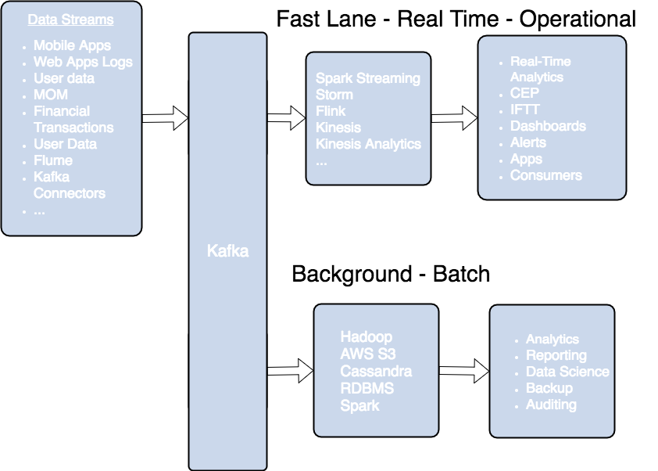
HWE: Kafka’s place within Big Data.
Kafka’s growth is exploding, more than ⅓ of all Fortune 500 companies use Kafka.
Kafka gets used most often for real-time streaming of data into other systems.
Kafka is a middle layer to decouple your real-time data pipelines.
Notes:
Kit gave an introduction to the Big Data Space. What is Kafka’s most used role within the Big Data space?
Used as a middle layer to decouple data pipelines. Kafka acts as a go between for services, applications, pipelines. Way for them to pass on information to each other.
Three people have used Kafka before.
Brian Keeter
Matt Denton
Nate Liston
Use them to share their ideas on Kafka and explain concepts.

Slide 5
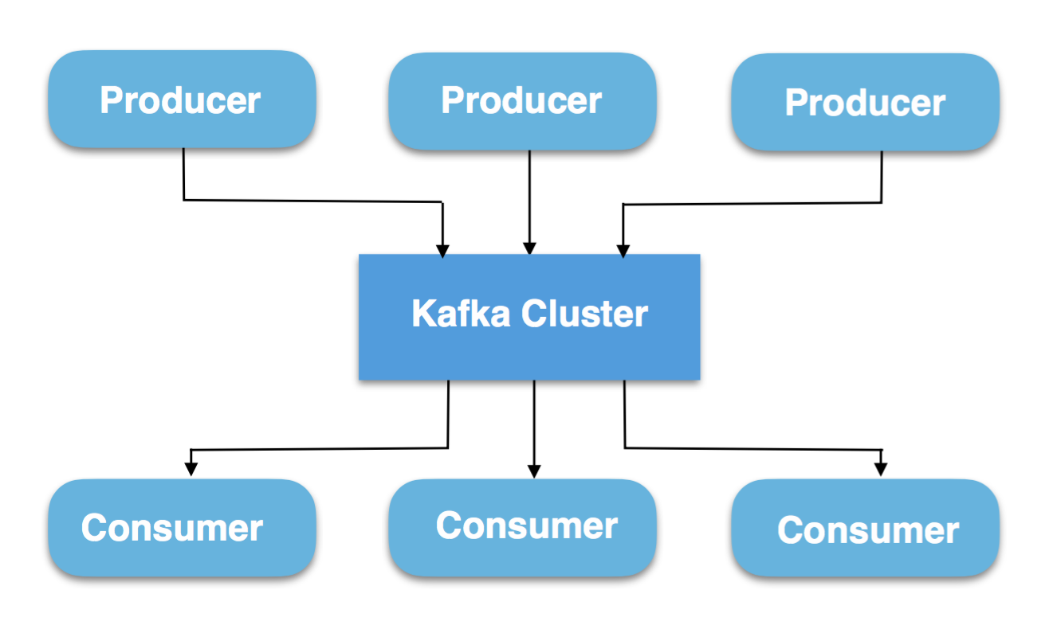
Apache Kafka
Apache Kafka is a publish-subscribe messaging system.
A messaging system lets you send messages between processes, applications, and servers.
Notes:
So what is Kafka? It is a pub-sub messaging system.
Applications that send messages to Kafka are called producers.
Applications that read messages from Kafka are consumers.
Because Kafka acts as the message broker. The producers don’t need to have knowledge of the consumers, and visa versa.
Without Kafka, each of the source applications need to have knowledge of their consuming applications.

Slide 6
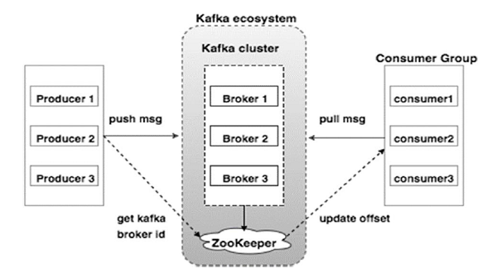
What is in the Kafka Cluster?
Broker: A server running Kafka
ZooKeeper: The manager. Zookeeper keeps track of status of the Kafka cluster nodes and it also keeps track of Kafka topics, partitions etc.
Zookeeper is popular in distributed systems.
Producer and Consumers: Applications which publish to (producer ) or read from (consumer ) the Kafka cluster.
Notes:
The number of brokers can scale horizontally. Kafka clusters can scale to 100s of brokers

Slide 7

Kafka Resource available to HWE - Data Engineering
Tim set up a cluster in Google Cloud Platform.
Three node Kafka instance w/ zookeeper.
Bootstrap Server Address:
35.208.65.122:9092
34.68.16.1:9092
35.225.151.65:9092
As we cover each section, let’s play with the server
in GCP.
Also, there are CLI, Java, and Python examples here:
https://github.com/farrellw/kafka-examples
Notes:
Diving into Kafka introduces a whole set of new words. Topic, producer, consumer, offset, partition, replication.

Slide 8
Kafka Basics
Notes:
export BOOTSTRAP_SERVERS=35.208.65.122:9092,34.68.16.1:9092,35.225.151.65:9092

Slide 9
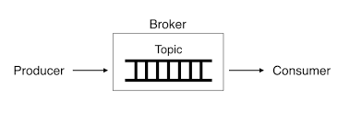
Topics
A Topic is a category / stream of data to which messages are stored.
Messages are byte arrays that can store any object.
Producer applications write data to topics and consumer applications read from topics.
kafka-topics --bootstrap-server $BOOTSTRAP_SERVERS --topic orders --create --partitions 4 --replication-factor 1
Notes:
Topic. The entry point into Kafka world.
A topic can be thought of as a category, or a stream of data to which messages are stored.
In the simplified picture here. A producer adds a message to the topic. And the consumer is reading from the topic.

Slide 10
Partitions in Kafka
Our cluster is running three nodes. Our earlier command created a topic with four partitions. And those four chunks are spread among the three nodes available.
Kafka automatically distributes these partitions across the servers.
Horizontal Scaling.
If we added another machine and create a topic, those partitions would be spread across four machines.
Question: Why is horizontal scaling advantageous? Vs. Vertical Scaling.
Describe the topic:
kafka-topics --describe --bootstrap-server $BOOTSTRAP_SERVERS --topic orders

Slide 11
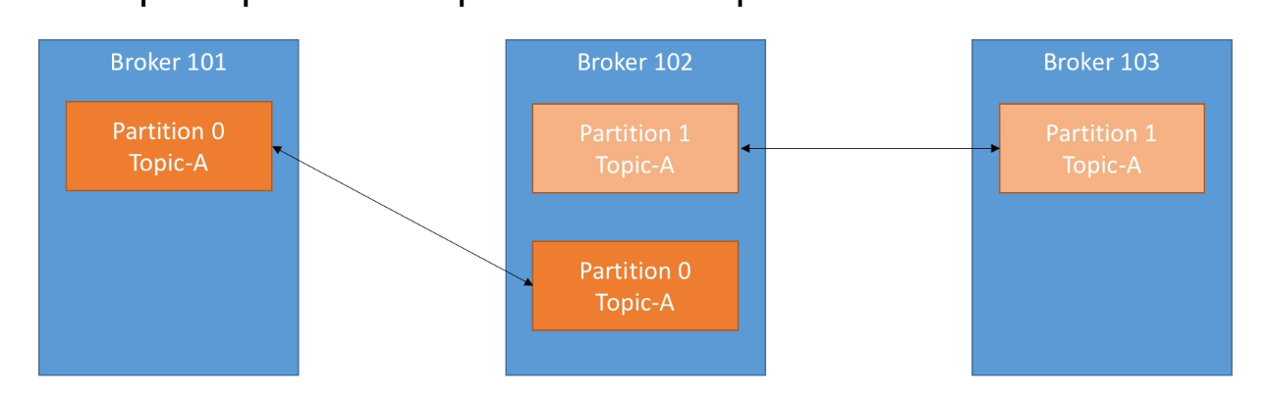
Replication in Kafka
Replication factor is specified when we create the topic.
How many copies of each partition. If we create a topic with a replication factor of two. Each of our four partitions will have the original and a copy. The copy will be placed on a different node than the original.
Question: Difference between replication and partitions?
Creating a topic with replication:
kafka-topics --bootstrap-server $BOOTSTRAP_SERVERS --topic orders --create --partitions 4 --replication-factor 2
Notes:
Replication works hand in hand with partitions. If partitions are the topic divided into chunks and distributed across servers.
Replication means to make a copy or multiple copies of each partition, and distributing them across the available servers too.

Slide 12
3 min practice
export BOOTSTRAP_SERVERS=35.208.65.122:9092,34.68.16.1:9092,35.225.151.65:9092
Create a kafka topic with 3-6 partitions and a replication factor of 2-3.
Give it your own name.
Run the describe command on your topic, seeing how the partitions are distributed across the three nodes.
Question:
What happens if you create a topic with a large number of partitions?
What about a large replication factor. Say.. 4 or 5?
Cheat Sheet :)
kafka-topics --bootstrap-server $BOOTSTRAP_SERVERS --topic will_f --create --partitions 4 --replication-factor 2
kafka-topics --bootstrap-server $BOOTSTRAP_SERVERS --describe --topic will_f
Notes:
Topics, Partitions, and Replicas are a big part of Kafka. So let’s set three minutes aside to practice. Create a kafka topic with 3-6 partitions and a replication factor of 2. And describe that topic, to check if those partitions are distributed across the three nodes.
You can connect to the cloud GCP instance.

Slide 13
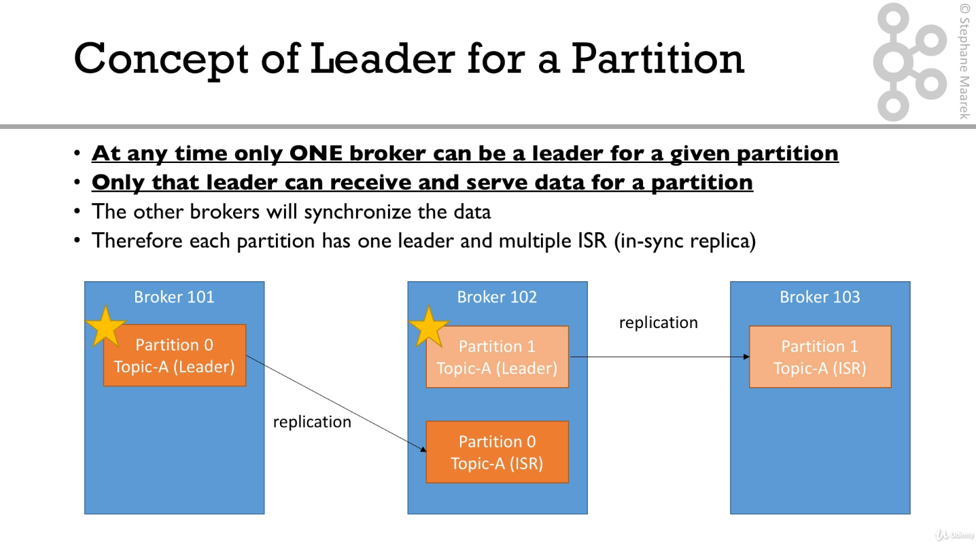
Add the concept of a leader to our diagram.

Slide 14

Questions
What happens when we kill a node?
Leader / ISR
When you bring that node back up, what happens to the leader?
How many machines can we afford to lose before we have data loss?
Does changing any of the following affect data loss?
# of nodes
# of replicas
# of partitions
What does it signify if the replicas stay out of sync for a long time?

Slide 15
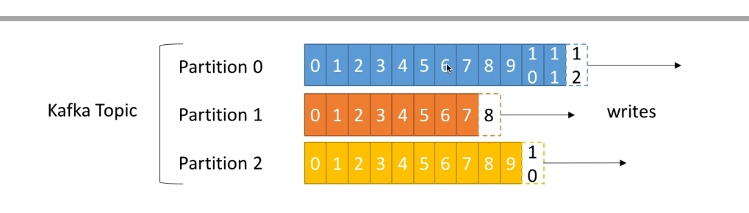
Offsets
The records in the partitions are each assigned a sequential id number called the offset that uniquely identifies each record within the partition.
Questions:
Which record was appended first? Partition 0, Offset 3 vs. Partition 0, Offset 6.
Which record was appended first? Partition 0, Offset 3 vs. Partition 1, Offset 6
Guarantees chronological order within a partition.
Notes:
A partition is an append only log. Each record within the partition is assigned an id. And, chronologically, if record A was appended to a partition directly after record B, then record A’s offset will be 1 higher than record B.

Slide 16
Producers and Consumers
Notes:
We have covered what is going on in Kafka. Now, let’s turn to interacting with Kafka. And that means we turn to producers and consumers.

Slide 17
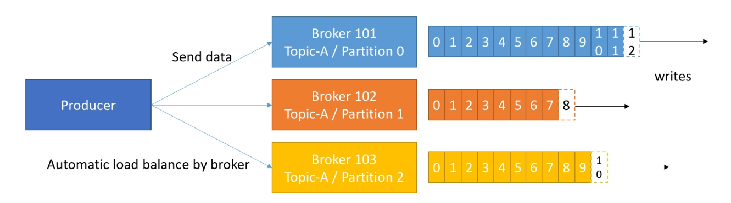
Producers
Kafka producers send messages to topics.
Append to the furthest offset.
Distribute messages between partitions/brokers automatically.
kafka-console-producer --broker-list $BOOTSTRAP_SERVERS --topic orders
Notes:
Connect a producer on the console. Leave that producer up, and let’s create a consumer!
Aside: Idempotent producer ensures exactly once message delivery per partition, in order to do so in multiple partitions, Kafka guarantees atomic transactions, which powers the applications to produce to multiple TopicPartitions atomically. All writes to these TopicPartitions will either succeed or fail as a single unit.

Slide 18
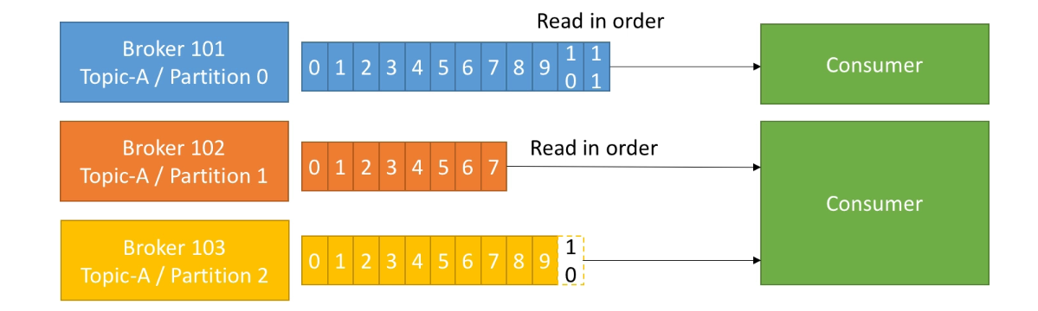
Consumers
Consumers read data from a topic.
Consumers automatically know which broker to read from.
Data is read in order, within each partition. Order not guaranteed across partitions.
kafka-console-consumer --bootstrap-server $BOOTSTRAP_SERVERS --topic orders
kafka-console-consumer --bootstrap-server $BOOTSTRAP_SERVERS --topic orders --from-beginning
Notes:
Consumers read data from a topic.
Consumers only need to know how to connect to the cluster, they don’t need to be told which Broker to read from.
Consumers read from an offset.

Slide 19
5 min practice
export BOOTSTRAP_SERVERS=35.208.65.122:9092,34.68.16.1:9092,35.225.151.65:9092
Find a shoulder partner.
Connect a producer to your neighbor’s topic they created earlier.
kafka-console-producer --broker-list $BOOTSTRAP_SERVERS --topic tim_s
Connect a consumer to your own topic you created earlier
kafka-console-consumer --bootstrap-server=$BOOTSTRAP_SERVERS --topic will_f
Send messages to your partner’s topic through the producer.
If you finish early: Work with your shoulder partner to create a consumer group. Pick one topic, and both applications should consume from the same application using the consumer group setting.

Slide 20
Producers & Acks
Acks = acknowledgements.
Setting to specify how many servers must your message be safely committed to before returning a success.
Question:
If we specify acks = all, what will happen if a server goes down?
Data Engineering concept of a `partition`, a slightly loaded term.
kafka-console-producer --broker-list $BOOTSTRAP_SERVERS --topic orders --producer-property acks = all
Notes:
Specify “acks”. Can someone explain what acks is doing. Test it out after killing a server.
In Data Engineering lingo, what happens what a `partition`, slightly loaded term there, occurs between two servers? When the two servers can’t communicate with each other.

Slide 21
Building a Kafka System Together

Slide 22
Building a Kafka System Together.
Client checks out of her cart using a web application. That request is transmitted to a server, which acts as a Kafka producer, publishing to a topic orders.
Group 1 ( Fraud Detection Service ) :
Builds an application that consumes from orders.
Application checks for fraud. Depending on if its a fraud, publishes a message to order-validation or fraud-detection.
Group 2 ( Customer Signup ) :
An application which creates new customers ( faker ) and publishes a message to the customers topic.
An application which listens to customers sends out email notifications ( prints to console )
Same application listens to orders and fraud-detection, sending out email notifications.
Group 3 ( Customer Preferences )
Builds an application which generates and publishes new orders to the orders topic.
An application which consumes from the orders topic.
Appends incoming order details to existing customer preferences ( faker ). Publishes an update of the customer preferences to the topic customers
Repo with premade CLI commands, Java clients, and Python clients: https://github.com/farrellw/kafka-examples
Notes:
Questions for discussion: Should customer signup and customer preference publish to the same topic?

Slide 23
Instructions to work in pairs:
Divide the room into 6 groups. These groups are numbered
1A, 2A, 3A, 1B, 2B, 3B.
Groups 1A, 2A, 3A all work with the topics appended with _A ( e.g. orders_A )
Groups 1B, 2B, 3B all work with the topics appended with _B ( e.g. orders_B )
Working with your partner to complete your piece of the application.
Diagraming your specific piece of the architecture ( which partitions are on which nodes, replication, etc. )
Diagraming how your specific piece fits into the overall architecture.

Slide 24
Questions:
What does flush do?
What is the encoding?

Slide 25
Theory + Kafka More if Time.

Slide 26
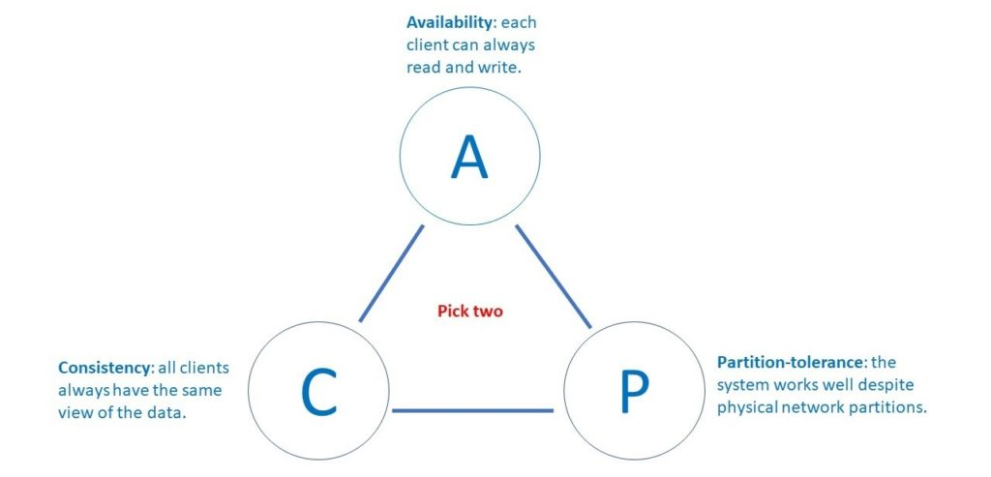
CAP
Notes:
The CAP theorem.
Does anybody want to explain what it is?
Where does Kafka fit within the CAP theorem.

Slide 27
Kafka Differentiator: Why is Kafka popular?
Kafka is simple
Easy to reason about
Scales horizontally
Kafka is fast
An append only, totally ordered data structure.
Writing to disk is often slow because it has to seek where to put the data.
Kafka writes to the immutable commit log to the disk sequential; thus, avoids random disk access, slow disk seeking.
Compression. Multiple messages sent to Kafka are compressed together.
Benchmark: https://engineering.linkedin.com/kafka/benchmarking-apache-kafka-2-million-writes-second-three-cheap-machines
Benchmark Code: https://gist.github.com/jkreps/c7ddb4041ef62a900e6c
Notes:
Kafka is the industry leader of pub / sub within the Data Ecosystem. Why?
35% of the Fortune 500. Many others use systems or concepts similar to Kafka.

Slide 28
Producers w/ Keys
Producers publish messages with an accompanying key when order matters.
Messages with the same key go to the same partition (customer_id as an example ).
kafka-console-producer --broker-list 127.0.0.1:9092 --topic orders --property parse.key=true --property key.separator=,

Slide 29
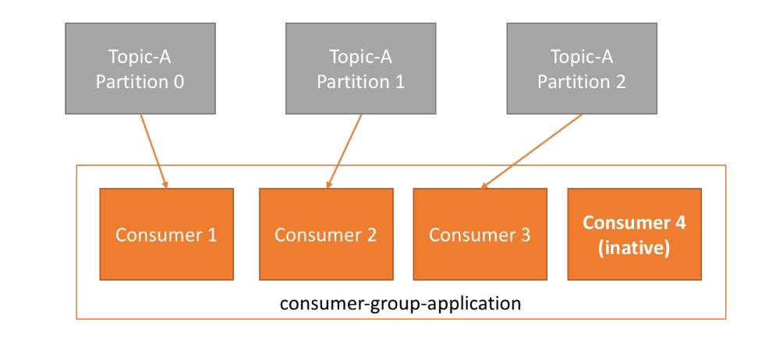
Consumer Groups
kafka-console-consumer --bootstrap-server=127.0.0.1:9092 --topic orders --group my-first-application
kafka-console-consumer --bootstrap-server=127.0.0.1:9092 --topic orders --group my-first-application

Slide 30
Leader based replication
One of the replicas is designated the leader. When clients want to write to the database, they must send their requests to the leader, which first writes the new data to its local storage.
The other replicas are known as followers. Whenever the leader writes new data to its local storage, it also sends the data change to all of its followers as part of the replication log or change stream. Each follower takes the log from the leader and updates it local copy of the database accordingly.
When a client wants to read from the database, it can query either the leader or any of the followers. However, writes are only accepted on the leader.
In Kafka’s case, reads and writes both are only accepted on the leader.
From the docs:
Each partition has one server which acts as the "leader" and zero or more servers which act as "followers". The leader handles all read and write requests for the partition while the followers passively replicate the leader. If the leader fails, one of the followers will automatically become the new leader. Each server acts as a leader for some of its partitions and a follower for others so load is well balanced within the cluster.
Notes:
Leader based replication.

Slide 31
Finding the Right Number of Partitions
“
Finding your optimal partition settings is as simple as calculating the throughput you wish to achieve for your hardware, and then doing the math to find the number of partitions needed. By a conservative estimate, one partition on a single topic can deliver 10 MB/s, and by extrapolating from that estimate you can arrive at the total throughput you require. An alternative method that gets straight into testing is to use one partition per broker per topic, and then to check the results and double the partitions if more throughput is needed.
Overall, a useful rule here is to aim to keep total partitions for a topic below 10, and to keep total partitions for the cluster below 10,000. If you don’t, your monitoring must be highly capable and ready to take on what can be very challenging rebalances and outages “
Source: https://www.infoq.com/articles/apache-kafka-best-practices-to-optimize-your-deployment/
Notes:
Leader based replication.

Slide 32
Feedback

Slide 33
Feedback
We want to make this course useful. Understanding that people come from many different experience levels.
Was the homework load about right?
Who watched the videos
Mix of work time vs. class time?
Reinforcing the basics versus going super advanced?
Logistics all right?
Food all right?
Notes:
Leader based replication.

Slide 34
Next week
Apache Spark (Week 1 of 2)
Videos
Scala Crash Course (Sections 1, 3 & 5) - 36 min
Spark Basics and Simple Examples - 64 min
Introduction to Spark
The Resilient Distributed Dataset
Ratings Histogram Walkthrough
Spark Internals
Average Friends by Age Example
Minimum Temperature by Location Example
Word Count
Total Amount Spent By Customer
Check your results against mine
Spark SQL, DataFrames, and DataSets - 28 min
Notes:
Leader based replication.

Slide 35
Appendix

Slide 36
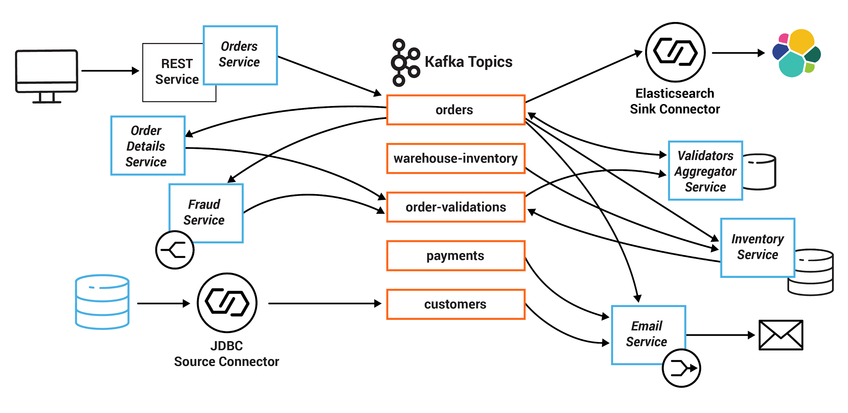
Topics
A Topic is a category to which messages are stored and published.
Messages are byte arrays that can store any object in any format
Producer applications write data to topics and consumer applications read from topics.
kafka-topics --bootstrap-server localhost:9092 --topic class_practice --create --partitions 6 --replication-factor 2
Notes:
The middle section are the different categories, or topics.
All the other squares here are applications that server as either producers or consumers. And in some case serve as both.

Slide 37
Notes and readings:
Consumer Assignments: https://www.signal.co/dev-log/kafka-consumer-assignments/
Thorough Introduction To Kafka: https://hackernoon.com/thorough-introduction-to-apache-kafka-6fbf2989bbc1
You can’t sacrifice partition tolerance: https://codahale.com/you-cant-sacrifice-partition-tolerance/
Kafka Transforming into “Event streaming database”: https://www.datanami.com/2019/10/01/kafka-transforming-into-event-streaming-database/
Benchmark: https://engineering.linkedin.com/kafka/benchmarking-apache-kafka-2-million-writes-second-three-cheap-machines
Benchmark Code: https://gist.github.com/jkreps/c7ddb4041ef62a900e6c
Zookeeper & Kafka: https://www.cloudkarafka.com/blog/2018-07-04-cloudkarafka_what_is_zookeeper.html
Practices to Optimize Deployment: https://www.infoq.com/articles/apache-kafka-best-practices-to-optimize-your-deployment/
Stop Calling databases CP or AP: https://martin.kleppmann.com/2015/05/11/please-stop-calling-databases-cp-or-ap.html

